Slide 1
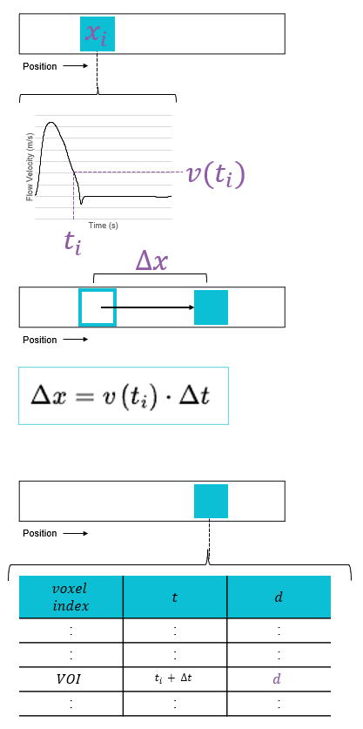
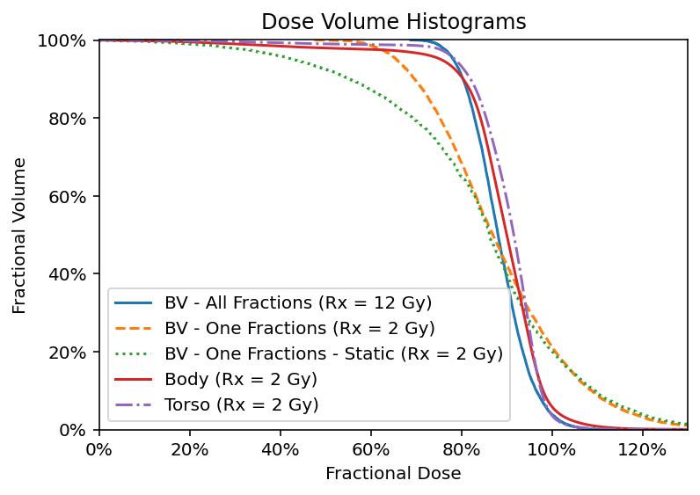
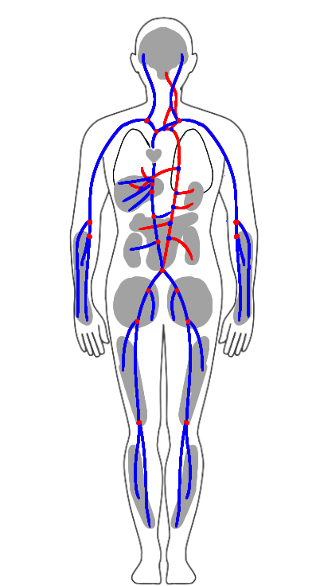
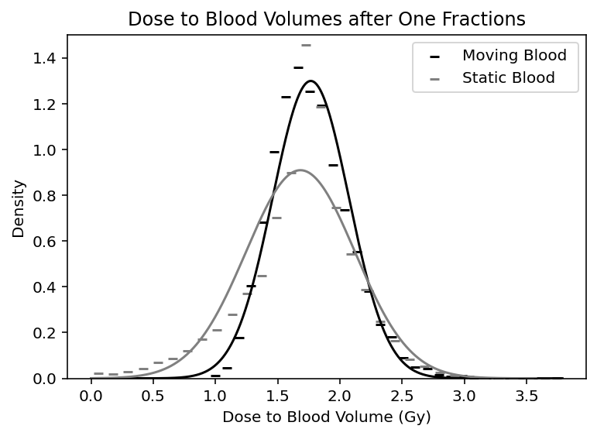
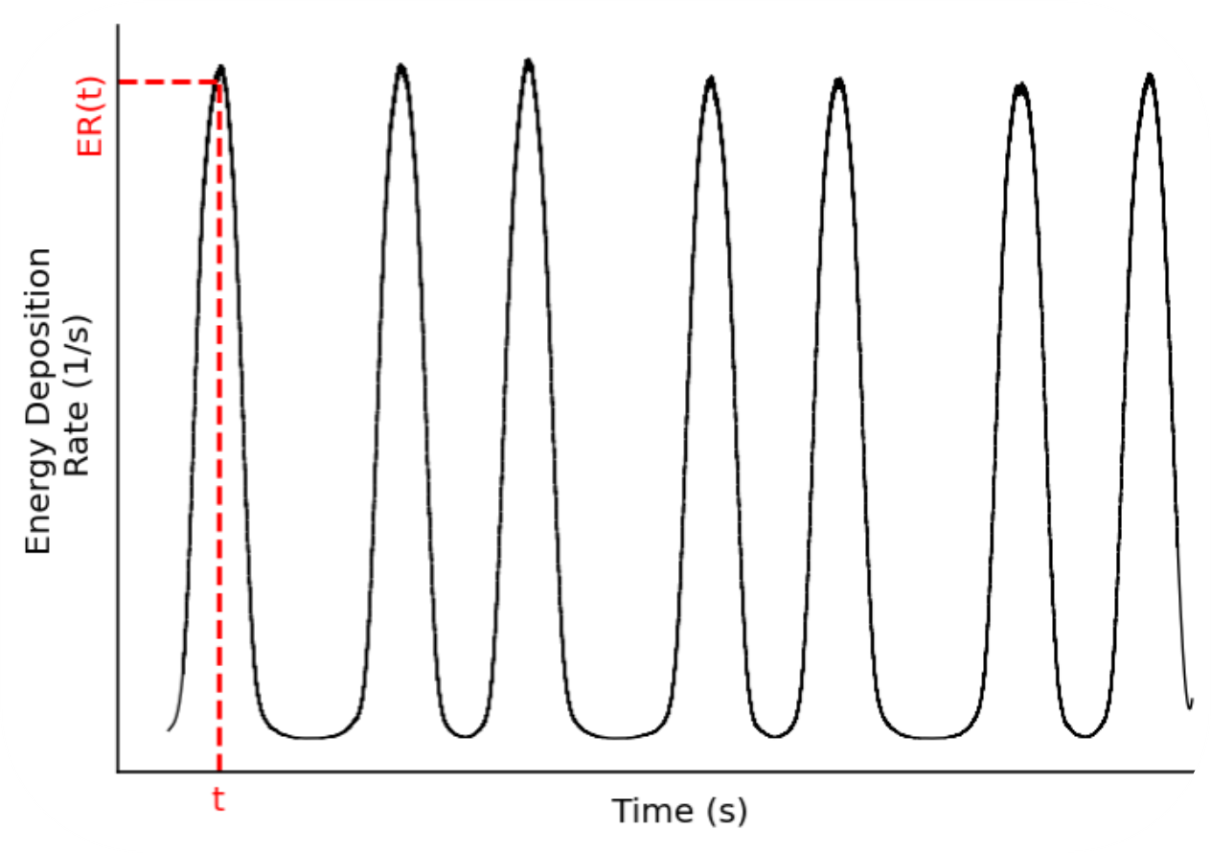
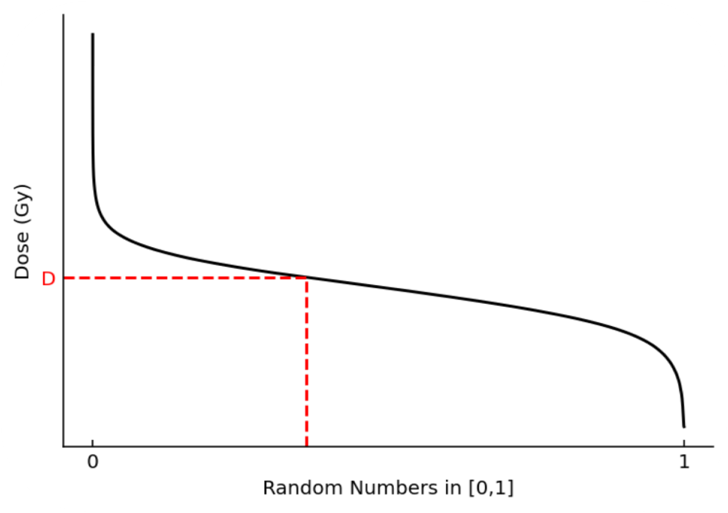
Assessing the Homogeneity Of Dose Delivered To Circulating Blood During Sweeping Cobalt-60 Total Body Irradiation
Names of
Title of the Research Project
Names of Presenters, Associates and Collaborators
How homogenous is the dose to the circulating blood volume achieved by sweeping Colbalt-60 Total Body Irradiation?
Dose Deposition Modelling
Detail about how we compute dose to the blood
FIGURES
Sweeping Co-60 TBI
Remarks
Title
Body text
Body trext can also be 18point
Introduction
Total body irradiation (TBI) : the entirety of the patients' body is irradiated to prepare them for stem cell transplant.
AAPM Report No 17: questioned whether TBI techniques, which do not simultaneously encompass the entire body, evenly dose residual cancer cells in the circulating blood [1].
One-Dimensional (1D) Blood Flow Modelling: determines the flow velocity (v) as a function of time (t) and displacement along the length of the vessel (x) and is well validated against clinical measurements [2].
Four-Dimensional (4D) Dose: computed using in-house modified EGSnrc [3], dose deposition events are binned by time and voxel location.
Methods
4D Extended Cardiac-Torso (XCAT) Phantom: a virtual phantom [4] which provided both the interaction medium for the 4D dose calculations and the vasculature models for the blood flow model.
Blood Flow Modelling
Vascular Network: a subset of vessels were extracted from the 4D XCAT phantom and the control points which define the contours were used to determine the length and radius of the vessels. Vessels were subdivided into segments at all branching points.
Compartments: act as zero-dimensional (OD) representations of small vessels, which are not modelled, which feed and drain organs and large gross volumes of tissue.
Arterial Flow: sourced from Nektar 1D [5], which generates pulsatile flow rates for major arteries. Results in two-dimensional (2D) arrays where the flow velocities is known for even spatial and time increments.
Venous Flow: sourced from in-vivo measurements across the literature and interpolation and the confluences rule were used to populate the network with non-pulsatile flow rates.
Transporting the BVs: at every time step (2 ms) the velocity profile
Tuning Dwell Times
Validation
Results
Note: Skip the following procedure if your graphs were created in PowerPoint®, Illustrator (eps file) or Excel.
Image checking procedure:
After you insert the image (if 72 dpi screen resolution) and resize* to fit, right click on it and select Format Picture. When the pop-up window comes up, click on size and check the scale. The image will print better if the width and height scale is at 25% or lower (20% or 10%, etc.)
If the scale of the image is higher than 25%, try to replace it with a larger size (more dpi, e.g. 300dpi) image if possible. (Note: This should not be done by manually stretching the image to a larger size.)
If the resolution of the image is 300 dpi or higher (400 or 600 dpi), then check to make sure its scale is not higher than 100%.
*To resize an image – Click on the image, hold down the Shift key and drag the corner to resize the image in proportion.
Tips for Excel Charts
Copy and paste your Excel chart.
The chart can be stretched to fit as required. If you need to edit parts of the chart, edit the original chart in Excel, then re-paste the new chart.
(Delete this box when inserting your text or image. This is only a reminder.)
Journal articles if cited in the reference section may be set in a smaller font. If your list is extensive and space is limited, consider setting these references in 12 point
Sample in 12 pt:
Journal Article, Name of Journal
Journal Article, Name of Journal
Journal Article, Name of Journal
Journal Article, Name of Journal
Key Results:
Info
Info
Info
Acknowledgements
Partner logos (if applicable) go on lower right
[1] VanDyk ICRp
Notes:
LINE SPACING IS 12
1[] vandyk icrp
[2] su 4ddose
[3] perdikaris et al 2016
[4] segars 2010
[5] alastruely 2012

Slide 2
Assessing the Homogeneity Of Dose Delivered To Circulating Blood During Sweeping Cobalt-60 Total Body Irradiation
Names of Presenters, Associates and Collaboratorsjj
Title of the Research Project
Names of Presenters, Associates and Collaborators
Poster Instructions & Guidelines
Please keep this file in your archives and for future reference. Make a duplicate copy for your working file.
If you need a different poster size than the files you have on hand, please contact Multimedia Services with your poster size request.
If this poster size is suitable for your project, copy and paste your text content here, adjusting the font size to fit.
Sample title
Please use Arial Bold for headings and subheads
Guidelines for title bar
Colour band at top must be in one of the BC Cancer brand colours.
– BC Cancer logo must appear at top left corner in the size shown
– Type sizes should be as indicated.
Guidelines for content
Please use Arial as your font.
Use the “Symbol” font for Greek characters.
Poster background must always be white for greatest readability.
Keep colour of titles, graphs, diagrams etc consistent with BC Cancer’s brand colours.
Partner logos can be place along the bottom of the poster, lower right.
Partner logos should be a similar size relative to each other and none of the other logos should look bigger than the BC Cancer logo.
Title:
Arial Bold, 54pt
Subhead Medium
Arial Normal, 36
Subhead Small:
Arial Normal, 28pt
Colour:
Our new BC Cancer brand colours are as follows:
This colour is Pantone 3115 and can be created in PowerPoint using the following RGB values:
R: 13
G: 191
B: 213
This colour is Pantone 2583.
It is set in PowerPoint in RGB values as follows:
R: 144
G: 90
B: 166
Body text should be set in black or 75% black. Headings can be set in one of the two brand colours as listed above.
Columns of Type
Columns of type should be a consistent width and aligned with each other at the top. Left justified, ragged right type is the suggested format.
Poster Background
The background of the poster must always be white.
Tips for Inserting Graphs
or Images
Note: Skip the following procedure if your graphs were created in PowerPoint®, Illustrator (eps file) or Excel.
Image checking procedure:
After you insert the image (if 72 dpi screen resolution) and resize* to fit, right click on it and select Format Picture. When the pop-up window comes up, click on size and check the scale. The image will print better if the width and height scale is at 25% or lower (20% or 10%, etc.)
If the scale of the image is higher than 25%, try to replace it with a larger size (more dpi, e.g. 300dpi) image if possible. (Note: This should not be done by manually stretching the image to a larger size.)
If the resolution of the image is 300 dpi or higher (400 or 600 dpi), then check to make sure its scale is not higher than 100%.
*To resize an image – Click on the image, hold down the Shift key and drag the corner to resize the image in proportion.
Tips for Excel Charts
Copy and paste your Excel chart.
The chart can be stretched to fit as required. If you need to edit parts of the chart, edit the original chart in Excel, then re-paste the new chart.
(Delete this box when inserting your text or image. This is only a reminder.)
Journal articles if cited in the reference section may be set in a smaller font. If your list is extensive and space is limited, consider setting these references in 12 point
Sample in 12 pt:
Journal Article, Name of Journal
Journal Article, Name of Journal
Journal Article, Name of Journal
Journal Article, Name of Journal
Title
Title
Body text
Body trext can also be 18point
Partners
Partner logos (if applicable) go on lower right

Slide 3
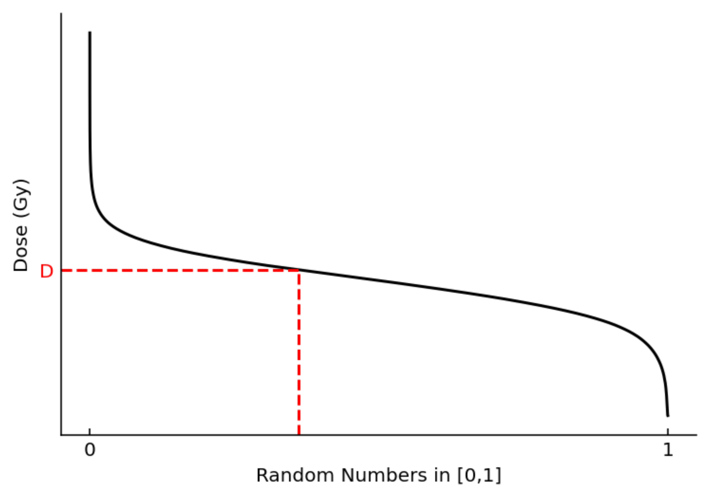
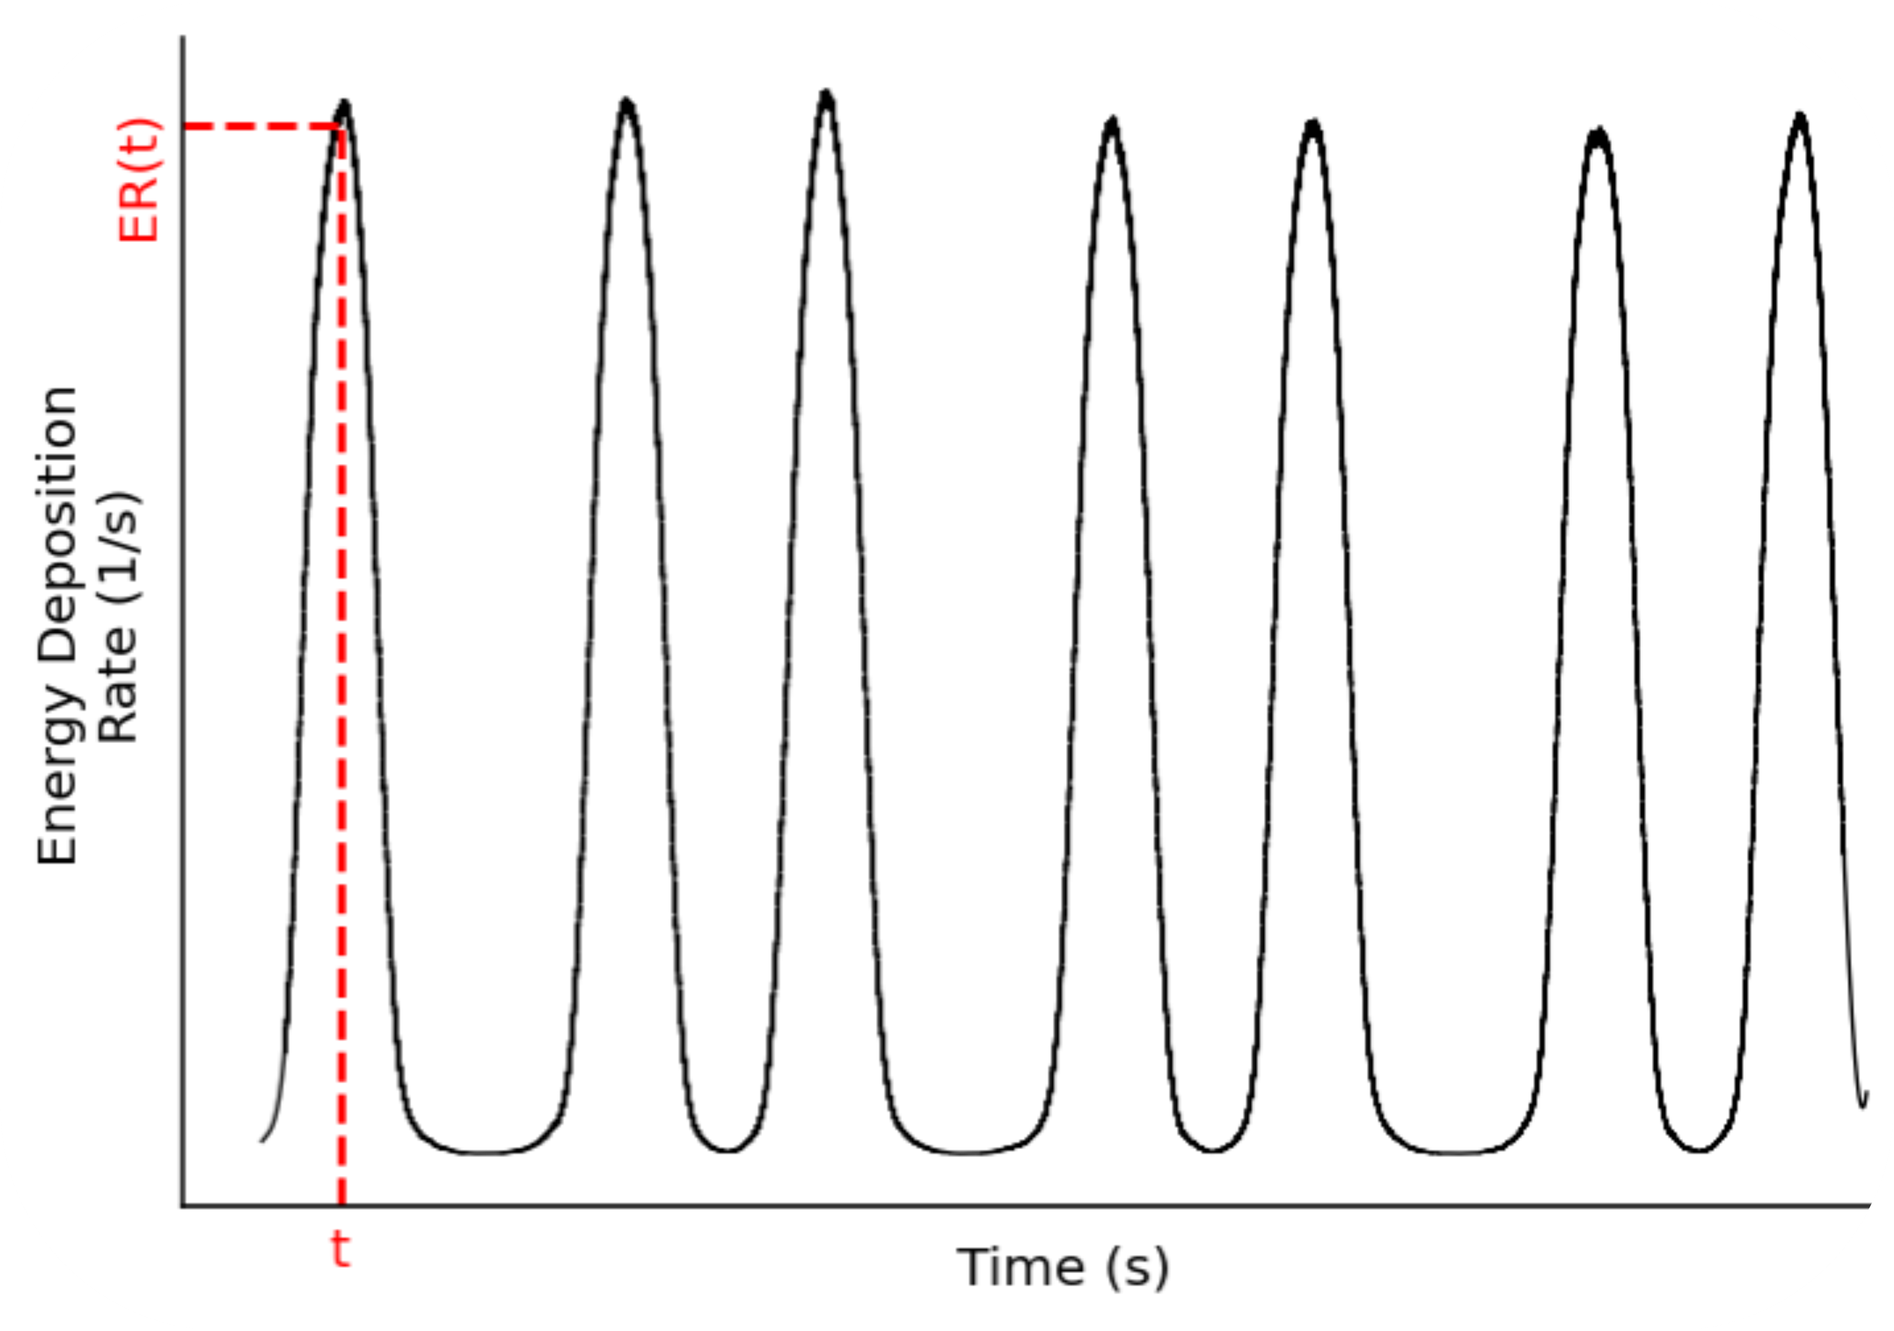


Slide 4

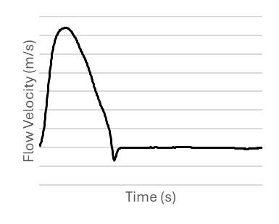




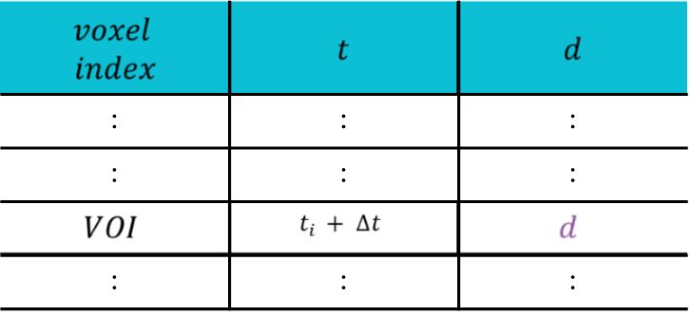
Position
Position
Position

